Slide 1
Steamin’ Ahead

Slide 2
Forms of Energy
Are the following energy forms potential or kinetic?
Chemical
Radiant
Nuclear
Electrical
Sound
Mechanical
Thermal
Notes:
Potential: chemical, mechanical, nuclear
Kinetic: electrical, sound, thermal, radiant

Slide 3
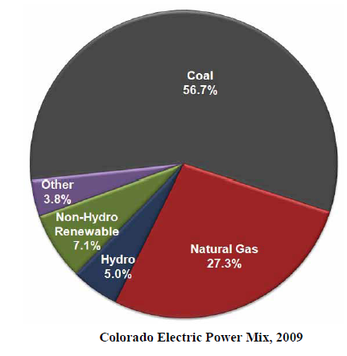
From 2010 Colorado Utilities Report
Notes:
Most electricity in Colorado is generated by burning fossil fuels – coal and natural gas - to create steam which turns a turbine. By using a generator, we are able to take mechanical energy (rotating turbine) and convert it into
electrical energy that we can use in our homes and schools.

Slide 4
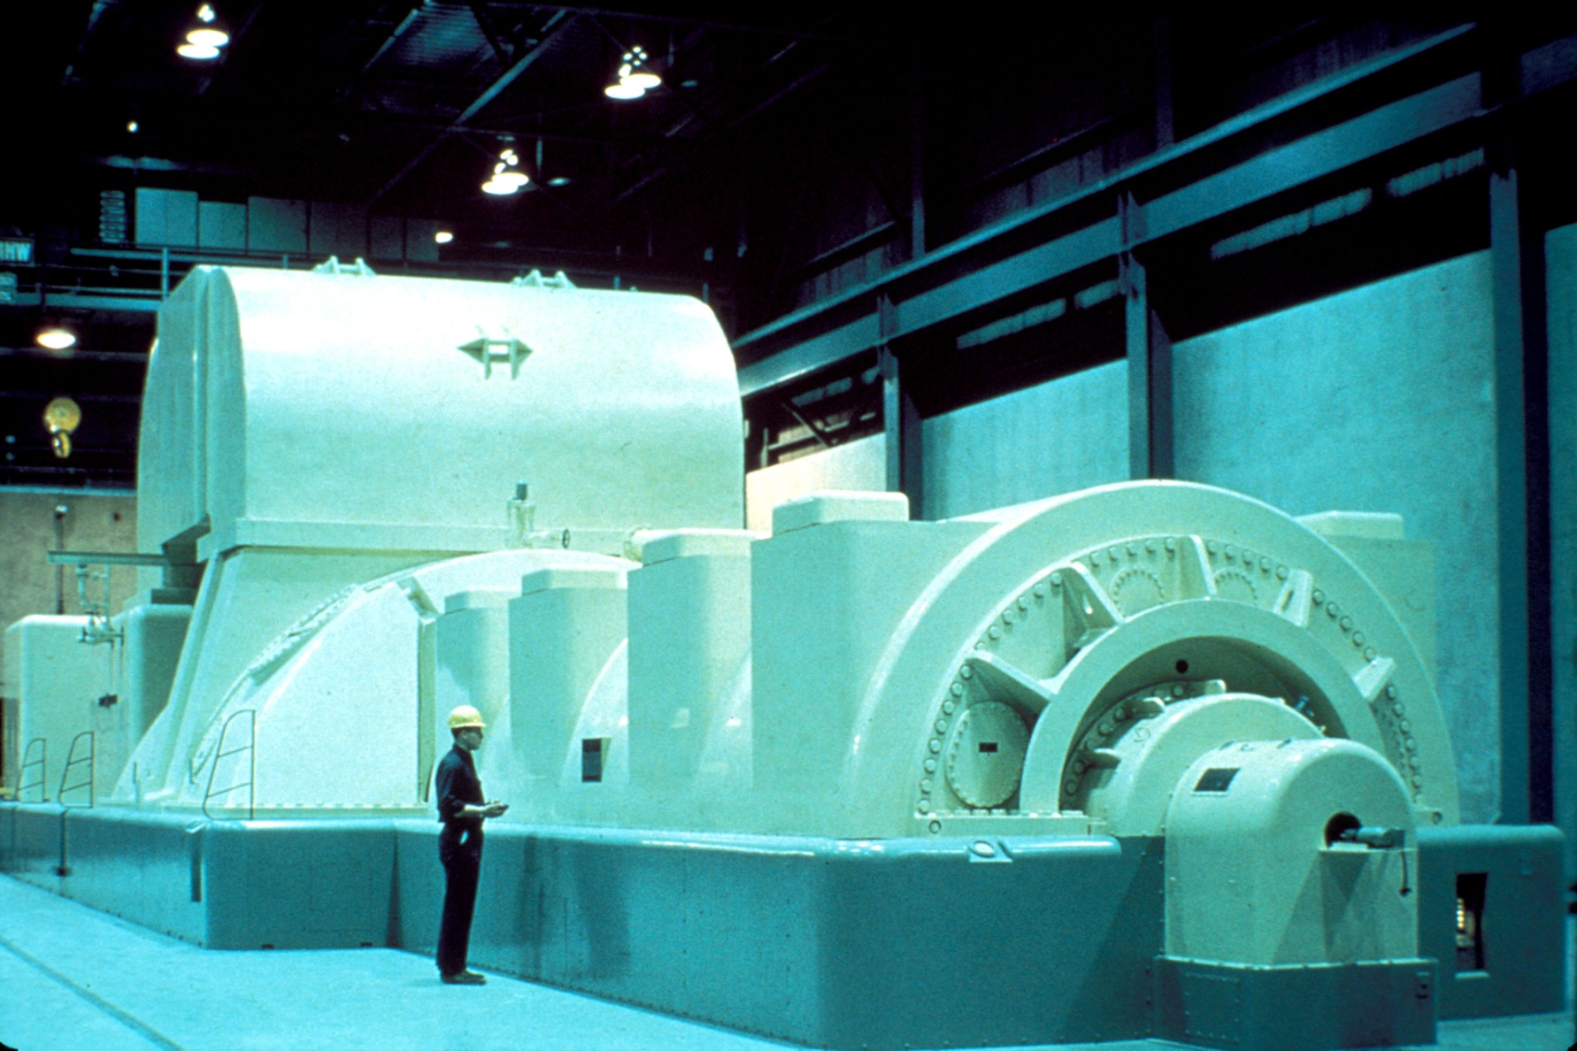
Notes:
Faraday’s Law tells us that a magnet must be moved inside a coil of wire to cause electrons to flow. You can also move the coil of wire inside the magnetic field to make electricity. A generator does this by having a rotating shaft with coils or magnets attached. On a steam turbine, for example, pressure from steam spins a giant rotor inside the generator.

Slide 5
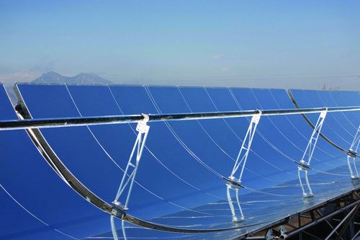
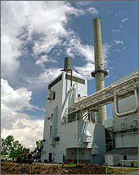
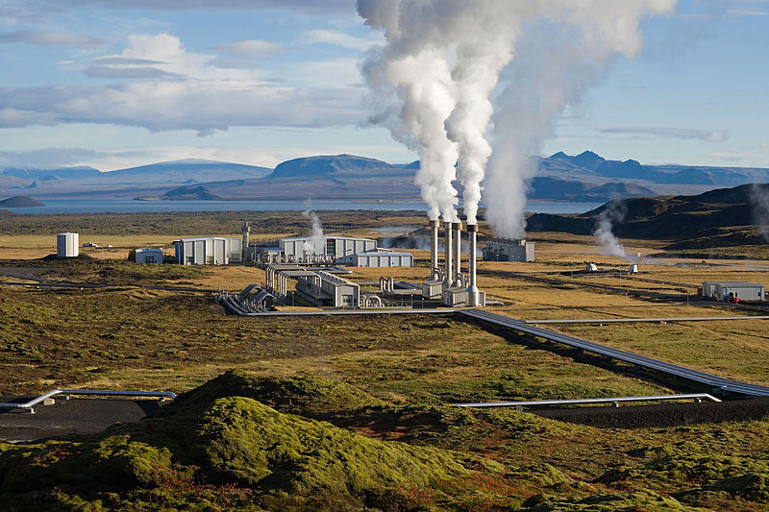
Notes:
Steam can also be generated by using parabolic troughs that concentrate solar power on a single point to produce heat, by burning biomass, or by developing the earth’s geothermal resources.
A concentrating solar plant was built in Palisade, CO in 2009 and another large plant is planned for Alamosa, CO.

Slide 6
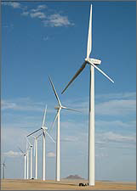
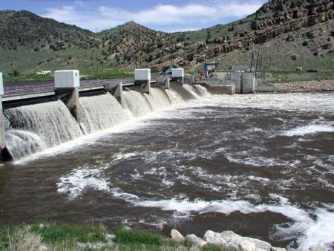
Notes:
Wind and water can also be used to generate electricity by spinning a turbine and don’t require steam.

Slide 7
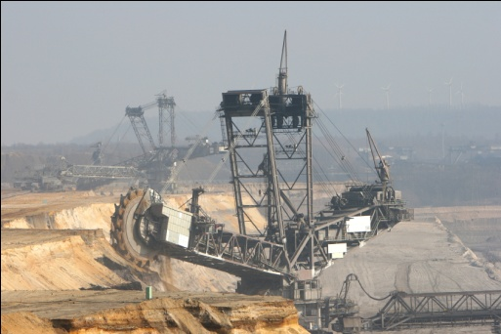
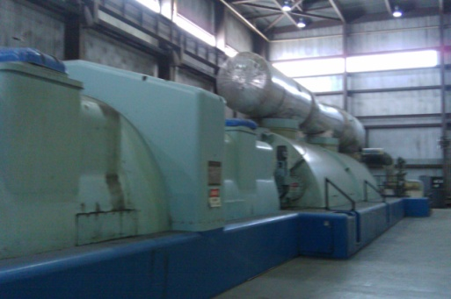
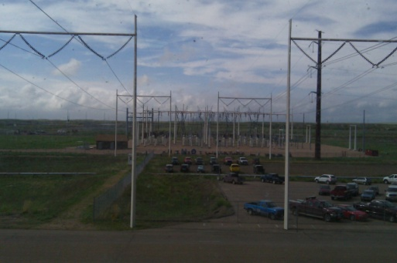
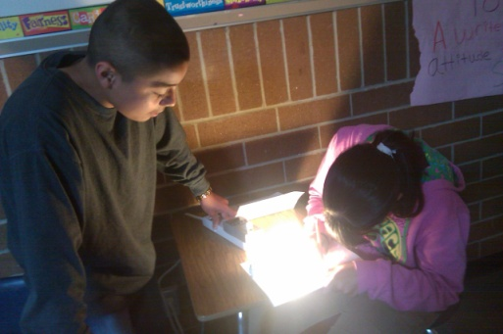
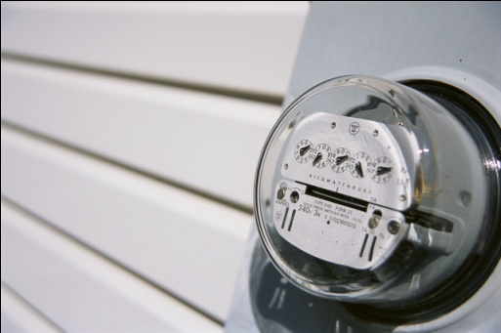
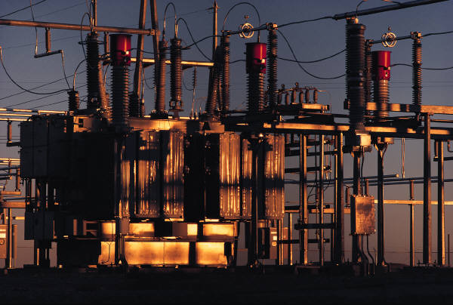
Thermodynamics
100 units
35 units
2.5 – 8 units
31 units
Notes:
Energy is:
Neither created nor destroyed
“Lost” when converted between forms
A typical coal power plant is 30-35% efficient at converting the BTUs stored in the coal into electrical energy BEFORE transmission. Solar panels can convert about 20% of the energy in sunlight into electrical energy.

