Slide 1
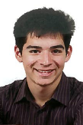
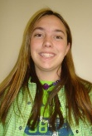
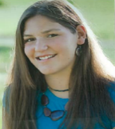
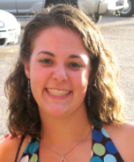
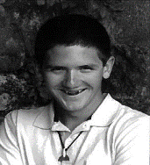
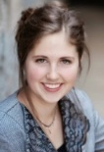

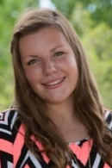


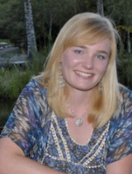
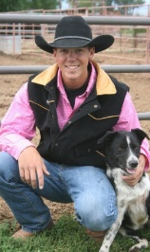


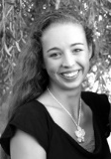
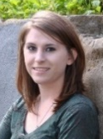

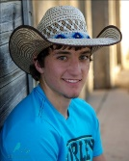
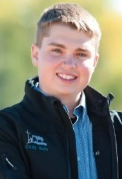

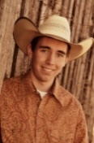
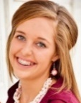
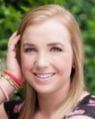
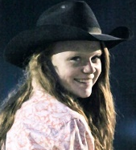
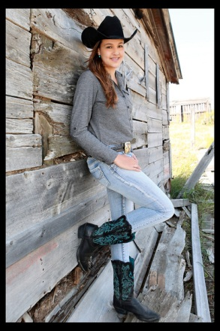
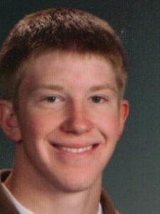

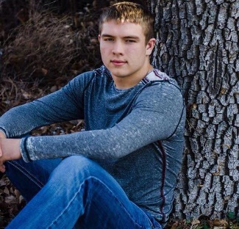

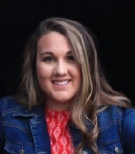
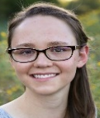
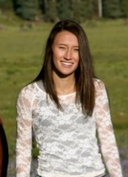
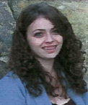
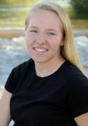

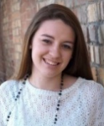
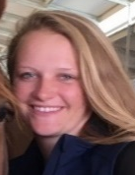
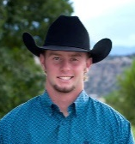
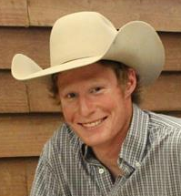


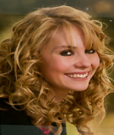
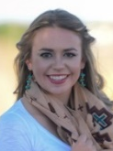
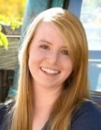
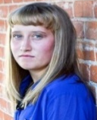
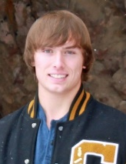
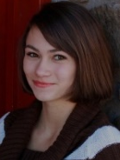
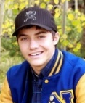
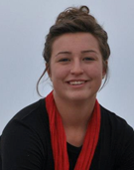
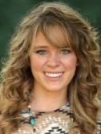
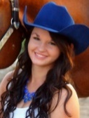
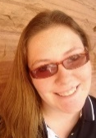

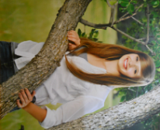
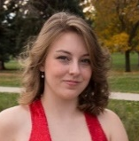
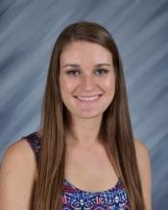
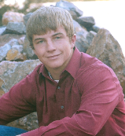
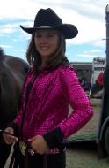
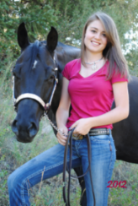
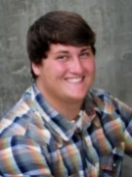
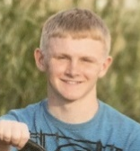
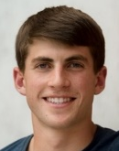
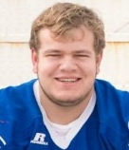

















































































Slide 2


Colorado 4-H Foundation, Inc. Colorado State University
2017 Scholarship Winners

Slide 3


1st Choice After School Kare 4-H Youth Scholarship
“The culmination of my 4-H experience has taught me many skills that I believe will help me thrive in post-secondary education.”
Carson Pachner
Washington County
Dordt College
Biblical Studies/General Agriculture

Slide 4

Colorado Agricultural Development Authority 4-H Youth Scholarship
“I credit my love for learning and my chosen career path to many of my experiences through 4-H. All these invaluable lessons will serve me well in all my future endeavors.”
Sara Reyher
Bent County
Otero Junior College
Animal Science

Slide 5

Colorado Agricultural Development Authority 4-H Youth Scholarship
“The … leadership skills that I have learned can make me into something better than what I was before.”
Ryan Koeller
Kiowa County
Lamar Community College
Agricultural Education

Slide 6

Colorado Agricultural Development Authority 4-H Youth Scholarship
“At the end of the day, I was still a winner if I gave it my all. 4-H is a tremendous organization and I’m fortunate to have benefitted from all the life lessons.”
*Also receiving a
2017 CSU Freshman Scholarship
Tyler Camblin
Phillips County
Colorado State University
Agriculture Business/Soil and Crop Science

Slide 7

Colorado Agricultural Development Authority 4-H Youth Scholarship
“4-H has taught me many valuable skills. These skills include hard work, work ethic, public speaking, time management (to name a few). I have been fortunate to have been mentored by teachers and 4-H leaders.”
Payton Swedlund
Logan County
Northeastern Junior College
Agriculture Education

Slide 8

Colorado Agricultural Development Authority 4-H Youth Scholarship
“The most important thing 4-H has taught me is self-discipline and responsibility. I know these are good lessons for me and that they will help me through college and my whole life.”
Colton Crawford
Baca County
Lamar Community College
Agriculture Business

Slide 9

Bill & Barbara Holthaus 4-H Youth Scholarship
“Throughout my years in 4-H I have become a stronger leader, a more relaxed public speaker, and a confident individual. 4-H has helped make me the person I am today.”
Jessalyn Bay-Voit
Montezuma County
Fort Lewis College
Business Management

Slide 10

Bill & Barbara Holthaus 4-H Youth Scholarship
“The 4-H program has made me a more confident and capable woman, a young adult ready to achieve success in my continuing education.”
Madison Mahaffey
Montezuma County
Colorado College
Foreign Languages & Cultures

Slide 11

Bill & Barbara Holthaus 4-H Youth Scholarship
“4-H has built the sturdy foundation of my character and work ethic, by developing valuable fundamental skills and discovering my passions.”
Nicole Doll
Morgan County
Western State Colorado University
Elementary Education

Slide 12

Kimberling Family 4-H Scholarship
“4-H has taught me professionalism, and I strongly believe that is a skill that will get me very far in life.”
*Also receiving a
2017 CSU Freshman Scholarship
Ashley Schilling
Larimer County
Colorado State University
Animal Science

Slide 13

Kimberling Family FFA Scholarship
“4-H has played a major role in my life and in developing me into the person I am today. 4-H has taught me about responsibility, hard work, and the utter importance of giving back to others and your community.”
*Also receiving a
2017 CSU Freshman Scholarship
Alaina Akey
Yuma County
Colorado State University
Animal Science

Slide 14

Kimberling Family 4-H Youth Scholarship – Continuing Education (Nutrition)
“I know that what I have learned and developed through 4-H will serve me well and I will be able to be successful.
Madessa Hoffer-Dye
Larimer County
Colorado State University
Animal Science

Slide 15

Betty Kimberling Memorial Scholarship
“All of the skills I learned in 4-H have helped me gain important life skills and mature at a young age to prepare me for the future.”
Kylie Casias
Adams County
Colorado State University
Health and Exercise Science

Slide 16

Murdoch’s Ranch & Home Supply
4-H Youth Scholarship
“The skills that I have gained through 4-H are irreplaceable. I have learned more than I thought I would have ever known…and now my future is going to be based off of (those skills). I believe my college experience will be much more fulfilling thanks to 4-H and the background it has set for me.”
Kaitlyn Boykin
Elbert County
University
Animal Science-Pre-Vet

Slide 17

Murdoch’s Ranch & Home Supply
4-H Youth Scholarship
Through 4-H, I learned first-hand about interesting careers, workforce requirements and how college students can survive and thrive at educational institutions such as CSU.
Wade Hofmeister
Morgan County
Northeastern Junior College
Animal Science

Slide 18

Murdoch’s Ranch & Home Supply
4-H Youth Scholarship
“4-H is a youth community that teaches leadership development and life skills through year long projects. Through 4-H, I have had the opportunity to inspire others in their projects, their lives.”
Christopher Benson
Boulder County
CU Boulder
Art History/Interior Design

Slide 19

Murdoch’s Ranch & Home Supply
4-H Youth Scholarship
“I believe the skills of leadership, public speaking and community service that I have learned through my 4-H experiences will help me succeed in college.”
Rebecca Watson
El Paso County
Fort Hays State University
Music Education

Slide 20

Murdoch’s Ranch & Home Supply
4-H Youth Scholarship
In 4-H, I had the opportunity of doing many things that prepared me to go to college. Activities, such as being on the TRA Livestock Judging Team, taught me public speaking and decision making skills.
Dean VanWinkle
Mesa County
Fort Scott Community College
Ag Business/Bovine Reproduction

Slide 21

Portouw Family Photography
4-H Youth Scholarship
I have learned through my years in 4-H that determination is key. The lessons 4-H has taught me will allow me to be successful in college and in life.
Cora Rhode
Morgan County
Concordia University
Music Therapy

Slide 22

Audrey Sandstead 4-H Youth Scholarship
“Through 4-H, I have done a lot of community service, which has given me a passion to care about what is going on around me. Because I have been in 4-H, I feel confident about going to college because of the skills I have learned.”
*Also receiving a
2017 CSU Freshman Scholarship
Taryn Santeramo
Weld County
Colorado State University
Dance/Health and Exercise Science

Slide 23

Howard E. & Marjorie M. Smith
4-H Youth Scholarship
“I am eternally grateful for my time as State 4-H Vice President, and all the people that made it the experience of a lifetime. The experience inspired me to utilize my love for leadership and politics to create change on a larger scale.”
Justis Marshall
Kit Carson County
Oklahoma State University
Agriculture Business

Slide 24

Charles and Margret Vezzetti Scholarship
“I am extremely grateful for the opportunities I received to grow as a person and leader as it has shaped me into the person I am today, all thanks to 4-H.”
*Also receiving a
2017 CSU Freshman Scholarship
Alyssa Loveless
Fremont County
Colorado State University
Biomedical Sciences/Pre-Vet

Slide 25

Colorado Rural Rehabilitation
Corporation (CRRC) Scholarship
“…confident, speak with ease, work ethic, work hard, handle stress…All of these skills are really going to help me in college, as I will be able to apply them to balancing school and a job, all while maintaining good grades...”
*Also receiving a
2017 CSU Freshman Scholarship
Olivia Brandt
El Paso County
Colorado State University
Biomedical Sciences

Slide 26

CCI (Colorado Counties Inc.) Foundation Youth Scholarship
“I have learned through 4-H that if you want something you have to earn it…no matter where I go or what struggles I face the skills I learned through 4-H will always help me.”
Sara Avila
Fremont County
Colorado State University-Pueblo
Early Childhood Education

Slide 27

Benjamin and Patricia Woods Scholarship
“4-H has impacted my life in tremendous ways, from (attending events) I have learned life skills. All of the skills I have learned has helped me make the decision to a career in agriculture.”
Kayla Luce
Montrose County
West Texas A & M
Ag Education/Ag Communications

Slide 28
CSU Freshman Scholarships

Slide 29

CSU Freshman Scholarship
“4-H has shown me that there is so much more to learning than just reading books and doing endless worksheets. Learning can also be real life experiences that develop new skills and hobbies.”
Kaitlyn Carson
Larimer County
Colorado State University
Agriculture Communications

Slide 30

CSU Freshman Scholarship
“Through 4-H I have attained the following skills: leadership, public speaking, responsibility, money management…and most importantly, having fun. 4-H is the only organization that I have participated in that teaches a wide variety of essential life skills.”
Monique Archibeque
Delta County
Colorado State University
Animal Science/
Microbiology & Genetics

Slide 31

CSU Freshman Scholarship
My dream to attend college is one of those dreams which 4-H has inspired me to pursue. By pursuing higher education, it will open up so many doors for me as well as the community that I live in, and that is a beautiful truth.
Lauren Thompson
Jefferson County
Colorado State University
Botany/Biology

Slide 32

CSU Freshman Scholarship
“Beyond (the) tangible skills I learned from my experiences in 4-H, I have also gained many personal skills. All of these facets (speaking, interaction, converse, analytical, etc.) combine to make me as prepared as possible for college and the rest of my future.”
Kolby Moore
Weld County
Colorado State University
Biomedical Sciences

Slide 33

CSU Freshman Scholarship
There was no way I could have known eleven years ago what adventure I was beginning. In some ways I am afraid to start a new life, but I know my 4-H experiences will help me.
Tabitha Lindahl
Gunnison County
Colorado State University
Music Education

Slide 34

CSU Freshman Scholarship
Through all of the experiences I had during my time in 4-H, I learned that no matter how many obstacles or how large they are, if I set my mind to it I can overcome anything.
Elizabeth Sage
Douglas County
Colorado State University
Animal Science/Pre-Vet

Slide 35

CSU Freshman Scholarship
“Through 4-H I have gained enough knowledge to know that I want to pursue, a career working with animals.”
Jacey Murphy
Grand County
Colorado State University
Zoology

Slide 36

CSU Freshman Scholarship
I have gained many skills by working hard to do projects, working with others, and organizing events. These skills of trying hard through stress are a major part of me…
Anderson Worcester
Douglas County
Colorado State University
Computer Engineering/Law Emphasis

Slide 37

CSU Freshman Scholarship
“However, for me, the most important experience in being a member of 4-H has been the relationships I developed with my fellow 4-H members, adult leaders, and volunteers. Their encouragement has taught me to take chances, trust my own decisions, and pursue my goals.”
Rylie MacLaughlin
Garfield County
Colorado State University
Biology (Health Care Field)

Slide 38

CSU Freshman Scholarship
“4-H has been an integral part of my life. As I grew in 4-H it taught me many skills, and helped me grow into the person I am today.”
Tyler O’Donnell
Montrose County
Colorado State University
Animal Science

Slide 39

CSU Freshman Scholarship
“Throughout my 4-H years, I have gained many opportunities and skills. I have also had the opportunity to meet many new people and develop social skills and healthy relationships.”
Diana Litzenberger
Boulder County
Colorado State University
Animal Science

Slide 40

CSU Freshman Scholarship
“Participating in 4-H has had a tremendous impact on my life and on my sense of hard work and community. 4-H presented an opportunity for me to work hard towards a goal that I cared about.”
Benjamin Morrow
Boulder County
Colorado State University
Engineering

Slide 41

CSU Freshman Scholarship
“4-H has helped me determine what I want to do and what I want to leave behind in my county. I want to further my education so that I can contribute my knowledge and help others learn as well.”
Aerica Melby
Garfield County
Colorado State University
Electrical/Mechanical Engineering

Slide 42

CSU Freshman Scholarship
“My 4-H experiences have prepared me to seek post-secondary education because it has shown me to enjoy learning and to seek out new things…it (4-H) has taught me to explore and to not be afraid to ask questions and even fail.”
Bailee Allyn
Elbert County
Colorado State University
Biology

Slide 43

CSU Freshman Scholarship
“I know college is the next step for me and my career, and I know that I will be walking into my degree program with the right experiences to get the most that I can out of my education.”
Renee Alderman
Douglas County
Colorado State University
Hospitality Management

Slide 44

CSU Freshman Scholarship
“…leadership is a delicate balance between authority and compassion…4-H has taught me leadership, persistence and compassion – even when I was knocked on the ground.”
Morgan Litchford
Larimer County
Colorado State University
Biochemistry

Slide 45

CSU Freshman Scholarship
“I have had the privilege of working with (fellow members of my club) and my leaders have taught me so much on what it means to be a member of a community and how we can give back to it.”
Jarred Bland
El Paso County
Colorado State University
Wildlife Biology

Slide 46

CSU Freshman Scholarship
“4-H has prepared me for a post-secondary education by teaching me to get out and talk to people…and leadership. 4-H is not only a lot of fun, but it teaches you valuable life skills in the process.”
Jarrett Schirmer
Pueblo County
Colorado State University
Civil Engineering

Slide 47
CSU Transfer Scholarships

Slide 48

CSU Transfer Scholarship
“It (4-H) has taught me to try things and find your passion as you help others find theirs…it’s about the relationships we make with other people and how to lift each other up to become successful.”
Valerie Crouse
Larimer County
Colorado State University
Agriculture Business/Biology

Slide 49

CSU Transfer Scholarship
“4-H taught me many life skills; love, compassion, dedication, and responsibility…because 4-H is about raising an animal from start to finish. These animals cannot survive without my help.”
Randilyn Madison
Montrose County
Colorado State University
Animal Science/Genetics

Slide 50

CSU Transfer Scholarship
“4-H has been a big part of my upbringing and the countless lessons I have learned from being involved in such a rewarding foundation are everlasting.”
Tia Konig
Weld County
Colorado State University
Agricultural Education/Animal Science

Slide 51

CSU Transfer Scholarship
“4-H has taught me many life skills but I believe the most important ones would be hard work and dedication. By being involved in each step of raising an animal you gain more knowledge…and realize the job opportunities in the field of agriculture.”
Bailey Schilling
Larimer County
Colorado State University
Animal Science

Slide 52
Congratulations
4-H Members!

