Slide 1
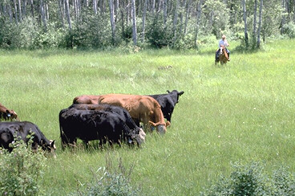
Development and Implementation of Extension and Applied Research Programs for Colorado Beef Cattle Production
Colorado State University
Beef Cattle Extension Position Candidate
Joel V. Yelich, PhD
Notes:
----- Meeting Notes (5/18/15 13:56) -----

Slide 2
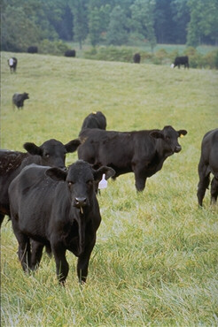
Introduction
Research program
Extension programs

Slide 3
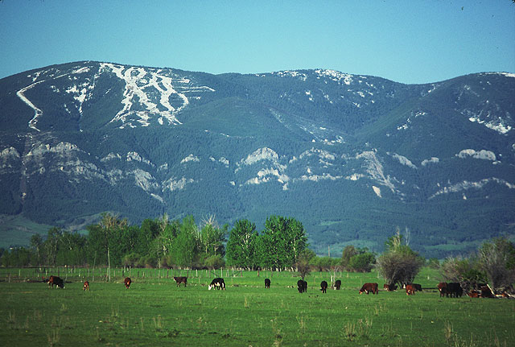
Introduction
Born and raised in Red lodge, MT

Slide 4

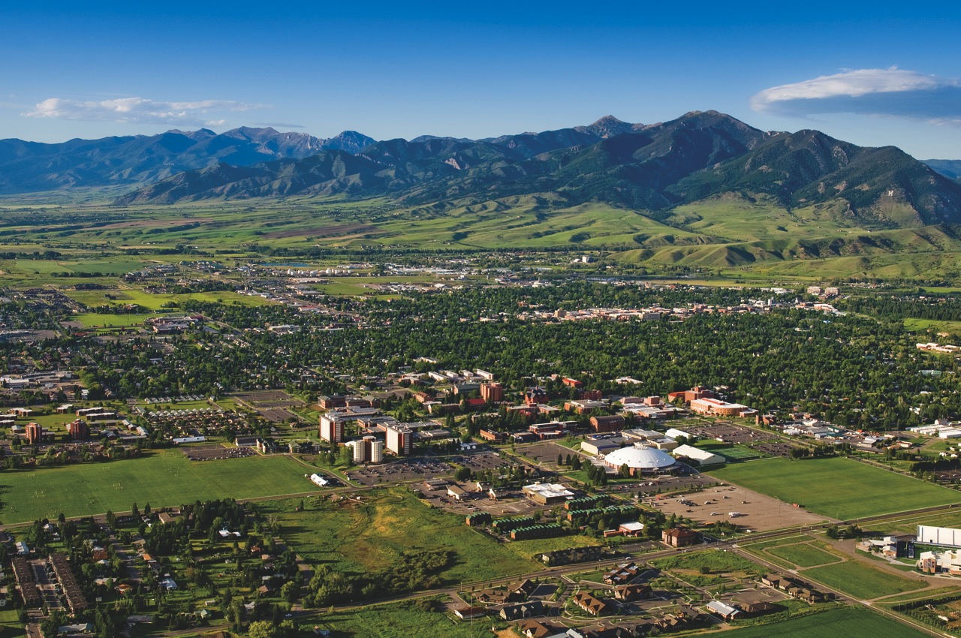
Introduction
Montana State University – BS
  Departmental farm
  Red Bluff Research Unit
  Internship at USDA-LARRS, Miles City
    Range nutrition & reproductive physiology internships

Slide 5
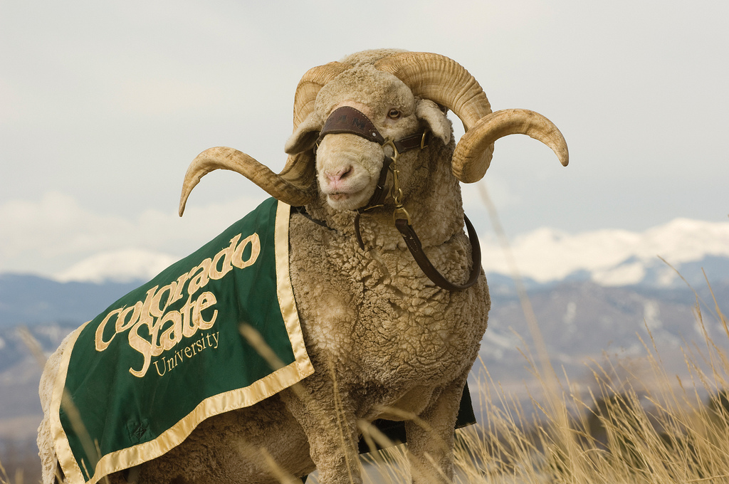
Introduction
Colorado State University – MS
  San Juan Basin Research Center, Durango
    Bull and ram test
    Coordinated research projects

Slide 6


Introduction
Oklahoma State University – PhD
  Effect of nutrition, body composition, and endocrine function on onset of puberty in beef heifers
    Exposure to teaching and extension work

Slide 7

Introduction
University of Florida
  Teaching and research appointment
    Undergraduate/Graduate Reproduction Courses
    Advisor Block and Bridle
  No official extension appointment
    Reproductive management schools
    Florida Beef Cattle Short Course
    Field days, breed associations, invited presentations
  Research
    Nutrition-Reproduction research
    Farm and ranch, demonstration projects
Notes:
,

Slide 8
Introduction
Research program
Extension program

Slide 9
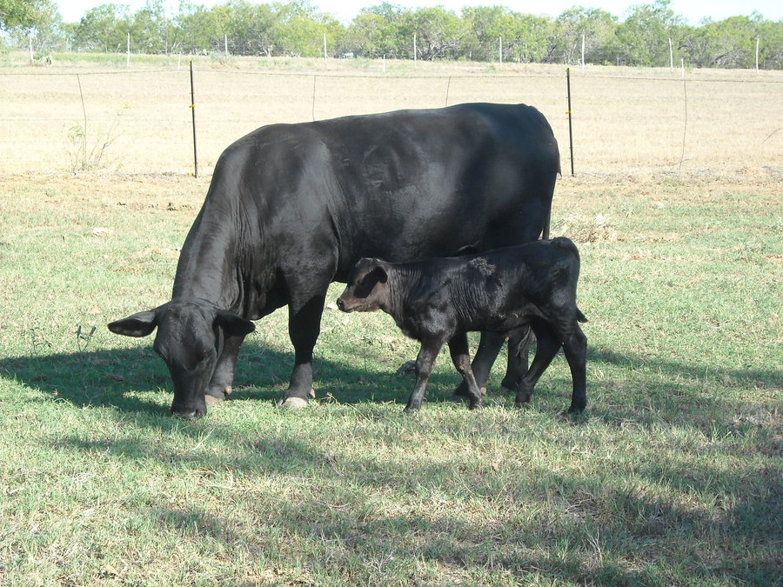

Development of synchronization systems in cattle of Bos indicus x Bos taurus breeding

Slide 10
Effect of GnRH + PGF_{2α} systems in suckled Bos indicus x Bos taurus beef cows
Pregnant (%)
Estrous Response
Conception rate to observed estrus
Conception rate to TAI
Pregnancy Rate
Lemaster et al., 2001

Slide 11
Co-Synch + CIDR Program
CIDR Insertion & GnRH
CIDR Removal & PG
GnRH & AI
CIDR
0 7 54 - 66 hr
Treatment days

Slide 12
Summary of CO-Synch 7 d CIDR in lactating Bos taurus beef cows (TAI 54-66 h)
# cows | % Pregnant to Timed-AI | Reference
215 | 59 | Busch et al., 2007
157 | 63 | Dobbins et al., 2006
365 | 45 | Kasimanickam et al., 2006
181 | 48 | Stevenson et al., 2003
599 | 52 | Kasimanickam et al., 2008
111 | 53 | Bridges et al., 2007
539 | 54 | Larson et al., 2006
201 | 56 | Bridges et al., 2007
111 | 68 | Bridges et al., 2007
170 | 55 | Dobbins et al., 2006
219 | 64 | Busch et al., 2007
Total
2868 | 54%

Slide 13
Effect of Co Synch + CIDR Fixed-TAI (48 hours) in Lactating Bos indicus x Bos taurus cows
Pregnant (%)
n=266
n=100
n=525
Experiments
Saldarriaga, et ., 2004; Yelich, 2000

Slide 14
Multi-location CIDR experiment in suckled cows of
Bos indicus x Bos taurus breeding
Day of experiment
-
0 7 8 9 10
  TAI-G
Co-Synch + CIDR


Select Synch + CIDR
  Estrus & AI
  TAI-G


 = GnRH (G)
 = PGF_{2α}
Esterman et al., 2015

Slide 15
Multi-location CIDR experiment in suckled cows of Bos indicus x Bos taurus breeding
Pregnant, %
1
2
3
4
5
Overall
Esterman et al., 2015

Slide 16
Calving distribution to a synchronized TAI followed by cleanup bull breeding
Schafer. 2005

Slide 17
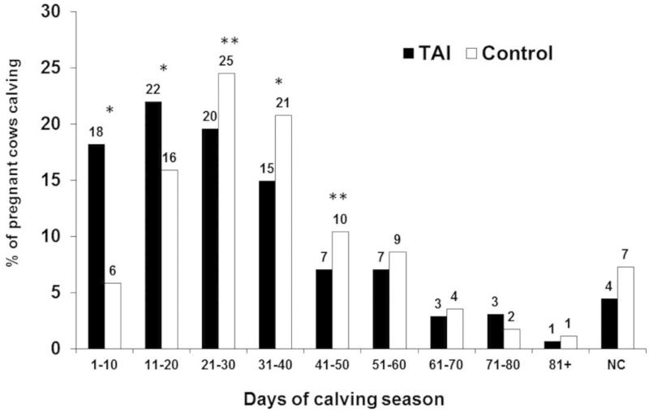
Percentage of cows calving by 10 d periods to either a TAI or natural service (Control)
* Within 10 d interval P < 0.01 ** Within 10 d interval P < 0.05) Rodgers et al., 2012

Slide 18
Lamb, 2014

Slide 19
Lamb, 2014

Slide 20
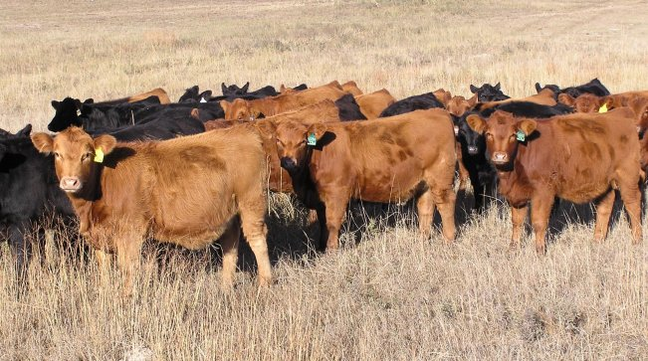
Replacement heifer development
Effect of body composition on attainment of puberty
Effect of supplementation/forage type & feeding frequency
  Forage type & Supplementation frequency
    Affected ADG and pregnancy rates
Effect of forage diet w/without an energy/protein supplement
  Using catch-up growth to decrease feed cost
Effect of heifer acclimation on growth & reproduction
Genetic component of reproduction
  Use of gene markers & genomics to facilitate heifer selection

Slide 21
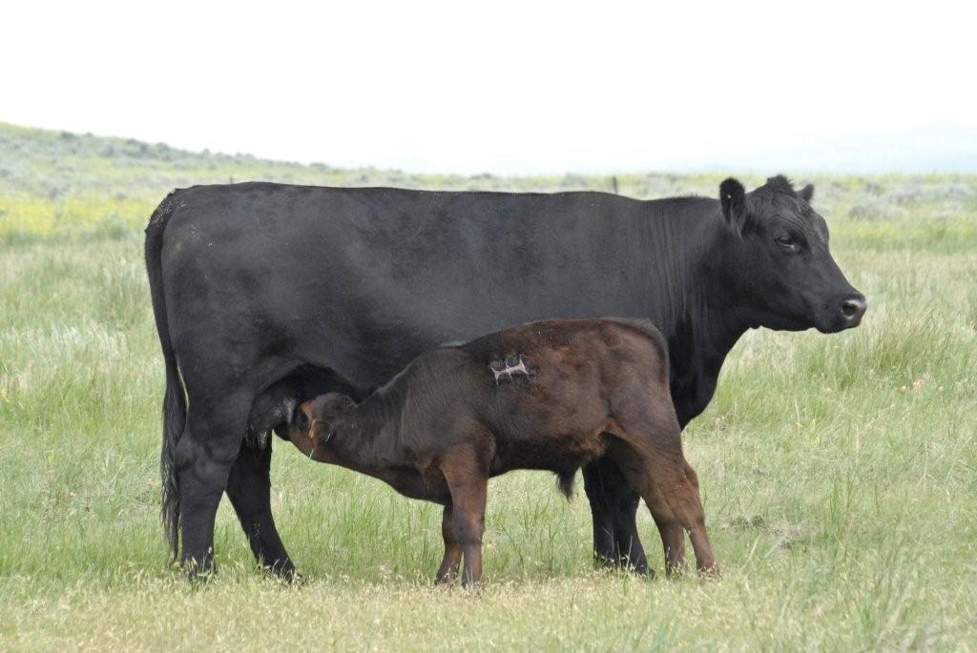
Comparison of feed additive technologies for preconditioning of weaned beef calves
M. Hersom*¹, A. Imler*, T. Thrift*, J. Yelich*, J. Arthington†
Journal of Animal Science. 2015.93:3169–3178
*Department of Animal Sciences, Gainesville
† Range Cattle Research and Education Center, Ona

Slide 22
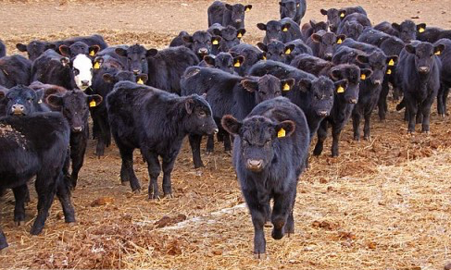
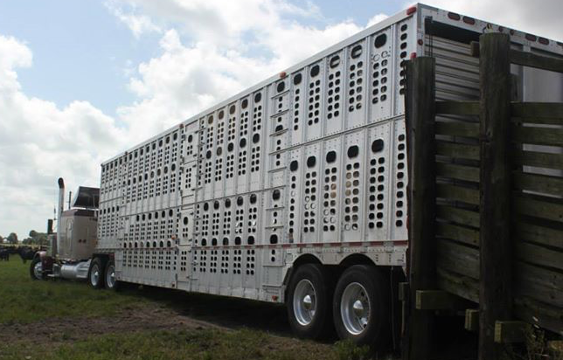

Slide 23
Preconditioning weaned calves
Demand for preconditioned calves has increased
  Reduces stress of weaning and shipping of calves
  Decreases morbidity and mortality in feedlot
  Allows for premium calf prices/added BW gain
Increased demand for natural and organic calves
  Decreased use of antibiotics
  Utilization of alternative products

Slide 24
Materials & Methods
Angus, Brangus calves
  Yr 1 (n=80 steers, n=80 heifers) Yr 2 (n=114 steers, n=63 heifers)
Treatments + wheat-mids cottonseed meal pellet (14%CP 67%TDN)
  Control supplemented with no additives (CON)
  Chloratetracycline (CYC) 350 g/hd/d
  Monensin (RUM) 175 mg/hd/d
  Rumen modifier (ACT) 5 g/hd/d (Actigen)
Drylot 0-7 perennial peanut hay
Pasture day 7-52 (yr1) 7-50 (yr 2) and yr 2 transport phase d 51-52
Intensive blood samples for Acute Phase Protein determination
  Yr 1: 0, 1, 4, 7, 11, 14
  Yr 2: 0, 1, 3, 7, 14, 50, 51, 52, 55, 59, 65, 66
Notes:
Mannan-containing products have been shown to affect innate and adaptive immunity in animals. Different products may have diverse immunomodulatory effects.
Actigen® (ACT, Alltech Inc., Nicholasville, KY) is a concentrated MOS product derived from the mannan fraction of a specific strain of Saccharomyces cerevisae. Actigen® supplementation also results in growth and intestinal improvements. On birds raised on dirty litter, the inclusion of ACT resulted in improved villus height, villus height to crypt depth ratio, goblet cell counts (Collett et al., 2011) and villus surface area (Barasch et al., 2011). Most interesting though are the effects ACT seems to have on the immune response. In weaned pigs infected with porcine reproductive and respiratory virus (PRRSV), ACT treatments improved antibody titers (Che et al., 2012).
Actigen acts as a rumen modifier and is a mono-oligosaccharide extracted from the yeast cell wall.

Slide 25
Notes:
a–cLeast squares means within a row without a common superscript differ (P < 0.05).
1CON, control, supplement without feed additives; ACT, supplement with Actigen (Alltech, Nicholasville, KY) at 5 g·d1·calf1; CTC, supplement with chlortetracycline at 350 g·d1·calf1; RUM, supplement with monensin at 175 mg·d1·calf1.
2 n = 32.
3 Starting weight (d 0) was taken by averaging d 0 and 1 BW measurements.
4Ending weight (d 52) was taken by averaging d 51 and 52 BW measurements.
5Day 0 to d 7 drylot period.
6Day 7 to d 52 pasture period.
7Premium of $0.11/kg of calf BW included in profit (loss) calculation.

Slide 26
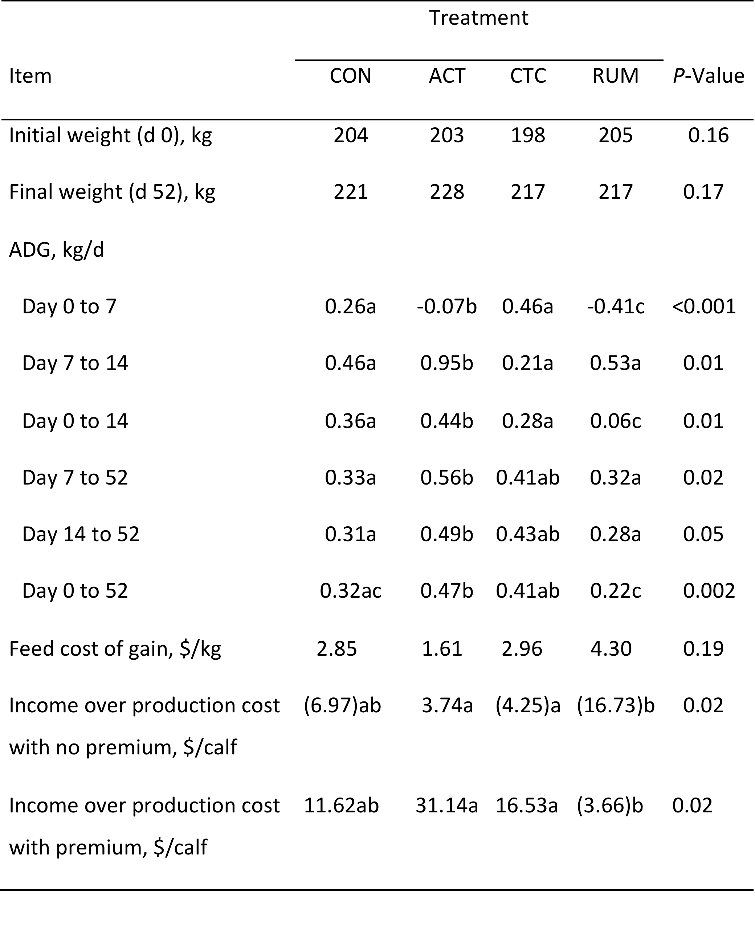
The effect of supplemental feed additive treatment on calf growth and economic outcome during backgrounding (Year 1)
Notes:
¹ CON (control, supplement without feed additives) ACT (supplement with Actigen at 5 g•d⁻¹•calf⁻¹) CTC (supplement with chlortetracycline at 350 g•d⁻¹•calf⁻¹) RUM (supplement with monensin at 175 mg•d⁻¹•calf⁻¹).
² Standard error (n = 32).
³ Starting weight (d 0) was taken by averaging d 0 and d 1 BW measurements.
⁴ Ending weight (d 52) was taken by averaging d 51 and d 52 BW measurements.
⁵ Day 0 to d 7 drylot period.
⁶ Day 7 to d 52 pasture period.
⁷ Premium of $0.11/kg of calf BW included in profit (loss) calculation.
^{ab} LS means within a row without a common superscript differ (P < 0.05).

Slide 27
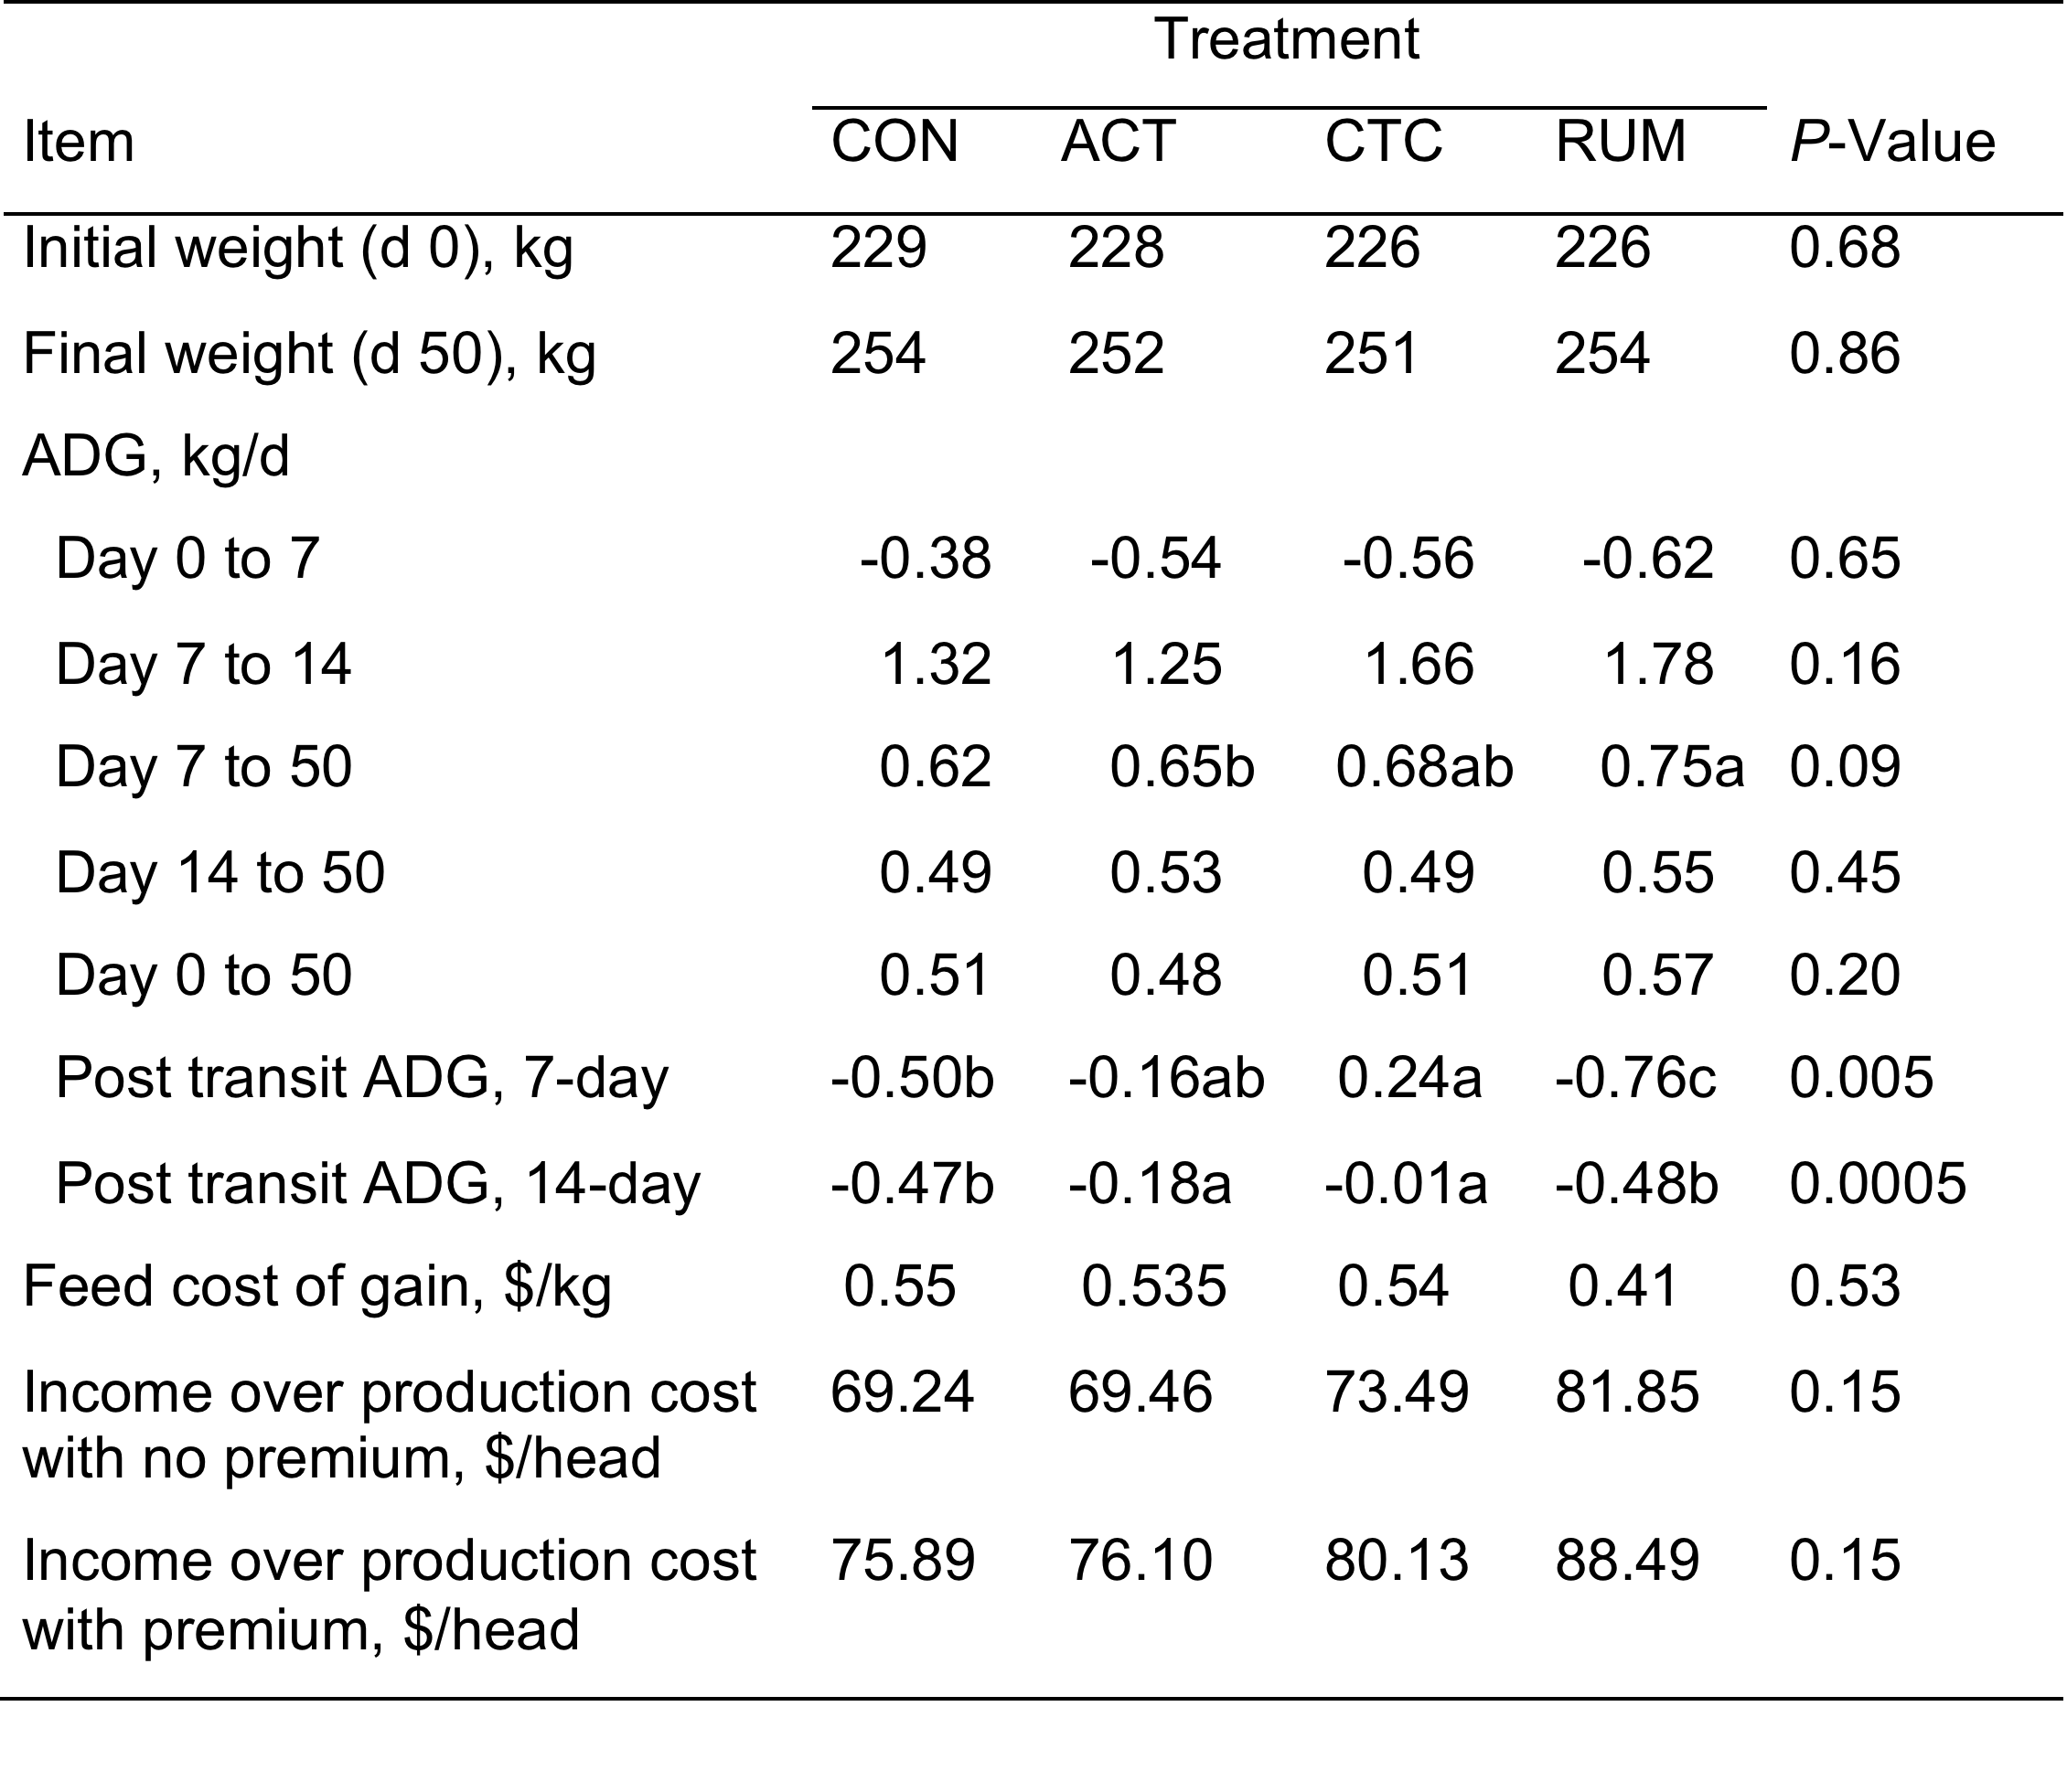
The effect of supplemental feed additive treatment on calf growth and economic outcome during backgrounding (Year 2)
Notes:
¹ CON (control, supplement without feed additives) ACT (supplement with Actigen at 5 g•d⁻¹•calf⁻¹) CTC (supplement with chlortetracycline at 350 g•d⁻¹•calf⁻¹) RUM (supplement with monensin at 175 mg•d⁻¹•calf⁻¹).
² Standard error (n = 32).
³ Starting weight (d 0) was taken by averaging d 0 and d 1 BW measurements.
⁴ Ending weight (d 52) was taken by averaging d 51 and d 52 BW measurements.
⁵ Day 0 to d 7 drylot period.
⁶ Day 7 to d 52 pasture period.
⁷ Premium of $0.11/kg of calf BW included in profit (loss) calculation.
^{ab} LS means within a row without a common superscript differ (P < 0.05).

Slide 28
Haptoglobin concentration of calves during 14 d post-weaning, yr 1, fed different feed additives
Day P < 0.0001
Notes:
Figure 1. Haptoglobin concentration of calves during 14 d post-weaning, yr 1. Day effect (P < 0.0001). Means at a particular point in time without a common superscript differ (P < 0.05).

Slide 29
Ceruloplasmin concentrations of calves during 14 d post-weaning, yr 1, fed different feed additives
Trt x Day P = 0.01
Notes:
Figure 2. Ceruloplasmin concentration of calves during 14 d post-weaning, yr 1. Treatment x day effect (P = 0.01). CON (control, supplement without feed additives), ACT (supplement with Actigen at 5 g•d⁻¹•calf⁻¹), CTC (supplement with chlortetracycline at 350 g•d⁻¹•calf⁻¹), RUM (supplement with monensin at 175 mg•d⁻¹•calf⁻¹).

Slide 30
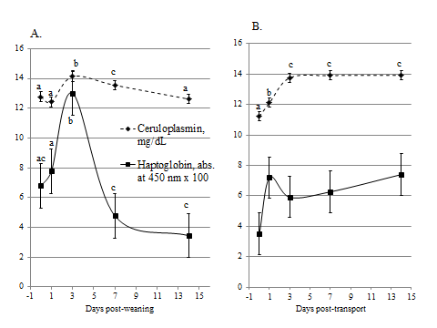
Haptoglobin & Ceruloplasmin concentrations of calves fed different feed additives (yr 2)
Day P < 0.0001; a,b,c P < 0.05
Notes:
Figure 3. A. Haptoglobin and ceruloplasmin concentrations of calves 14 d post-weaning, yr 2. Day effect (P < 0.0001). Means at a particular point in time without a common superscript differ (P < 0.05). B. Haptoglobin and ceruluplasmin concentrations of calves 14 d post-transit following a 50-d preconditioning period, yr 2. Day effect (P < 0.0001). Means at a particular point in time without a common superscript differ (P < 0.05).

Slide 31
Conclusions
No one particular technology consistently elicited a superior performance response
Administering ACT may work as effectively as the CTC and RUM in pasture based back-grounding systems
None of the feed additives had an effect of mitigating the stress response of weaning over supplementation alone as determined by the acute phase protein response

Slide 32
Comparison of Trace Mineral Source on Beef Cattle Performance and Reproduction
D Price¹, M. Hersom¹, M. Irsik²,
O. Rae², J. Yelich¹
¹Department of Animal Sciences ² College of Veterinary Medicine

Slide 33
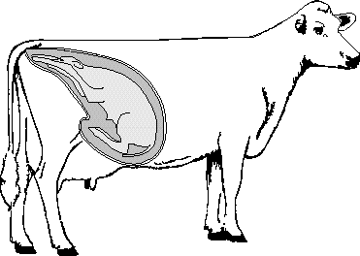
Placental Growth & Development
In utero Nutrient Transfer & fetal development
Calf Postnatal Nutrition (colostrum/milk)
Calf Growth, Immunity, Performance & Reproduction
Maternal & Environmental Factors

Slide 34
Impacts on Maternal Environment That Can Potentially Alter Offspring Developmental Trajectory
Factors
Outcomes
Nutrition
  Restriction vs excess
  Protein, lipids, minerals
Environmental Stressors
  Weather, Temperature
  Handling or Transport
  Predator Risk
Health
  Vaccination
  Disease status
Negative
  Neonatal mortality
  Incidence of respiratory diseases
Positive
  Performance – growth, WWT, ADG, & carcass
  Pregnancy rates

Slide 35
Mineral Studies
Trace minerals (TM) have various effects throughout an animal’s body - biochemical, physiological, & immunological.
TM supplement source; organic (ORG) or inorganic (ING), has been shown to affect their bioavailability in animals (Spears, 1996)
Breed differences in liver & plasma TM concentration are known to exist (Pogge, et al., 2012).
Easily administered treatments ➔ postnatal enhancements
  Enhance cow reproductive efficiency
  Enhance calf growth, immunity, and health prior & at weaning

Slide 36
Breeding season pregnancy rates
Inorganic vs. Organic
Group | Inorganic (% pregnant) | Organic (% pregnant) | P - Value
1 | 334/358 (93.3) | 337/356 (94.7) | 0.65
2 | 306/340 (90.6) | 268/280 (95.7) | 0.006
3 | 262/275 (94.9) | 268/280 (95.7) | 0.44
Total | 901/973 (92.6) | 873/916 (95.3) | 0.01

Slide 37
Adjusted Weaning Weights (2 years)
Inorganic (ING) vs Organic (ORG)
BW, lbs
(309)
(309)
(310)
(336)

Slide 39
Materials & Methods
Mature pregnant cows (191 cows)
2 x 2 factorial design:
  Treatments (TRT): trace mineral supplement
    Organic (ORG, yeast source)
    Inorganic (ING, salt sulfates)
  Breeds:
    Angus (AN)
    Brangus (BN)
Intensive blood and liver samples
  40 cow-calf pairs divided equally across TRT & Breed
  Parturition: colostrum sample from cow
    Calf blood samples: pre-nursing, 12 h, 24 h, 30 d

Slide 40
Materials & Methods
Component | ING | ORG
DM, % | 88.5 | 88.5
CP, % | 14.9 | 14.9
TDN, % | 70.6 | 70.3
Ca, % | 0.21 | 0.19
P, % | 1.00 | 0.99
Mg, % | 0.46 | 0.46
K, % | 1.36 | 1.35
S, % | 0.22 | 0.16
Co, PPM | 19.11 | 16.69
Cu, PPM | 259.85 | 149.65
I, PPM | 53.8 | 20.05
Fe, PPM | 406.79 | 406.15
Mn, PPM | 366.97 | 283.87
Se, PPM | 7.10 | 6.80
Zn, PPM | 891.88 | 526.43
Vit A, IU/lb | 31606.87 | 31606.87
Vit D3, IU/lb | 2835 | 2835
Vit E, IU/lb | 300.93 | 300.93
Mineral supplementation started ~ 90 d prior to expected parturition.
TM supplement provided:
  1.0 lb/1000 lb BW/day
  Delivered 3x/week in a pellet.
  Free-choice loose mineral during breeding season through weaning
Trace minerals in the supplement included:
  Cu, Co, Fe, I, Mn, Se, Zn
Notes:
The Bioplex range consists of organic Zinc, Copper, Manganese, Iron and Cobalt
Zinc is a trace mineral that forms an essential part of many very important enzyme systems involved in keeping dairy cows healthy, fertile and performing at their maximum. It is involved in disease resistance, skin and coat condition, and in structural soundness of the hoof and udder. Many trials and practical farm results with Bioplex Zinc (eg Harris 1995) have shown:
reduced incidence of lameness reduced somatic cell counts (SCC), especially when combined with Bioplex Copper a general improvement in cow health, fertility and production
What is Bioplex Zinc?
Bioplex Zinc is the brand name for an organic zinc complex produced by US-based bioscience company, ALLTECH. It is produced by reacting zinc with very small particles of hydrolysed protein, known as peptides, or amino acids. The peptides and amino acids protect the zinc and make it more available to the cow.
How does zinc from an organic compound like Bioplex Zinc compare with zinc from typical inorganic sources like Zinc Oxide and Zinc Sulphate?
Bioplex Zinc administration to dairy cows gives better cow response than ordinary zinc sources because more of the zinc is absorbed and utilised. This results firstly from the zinc being protected in the cow’s gut from adverse effects of other minerals and secondly from a higher percentage being absorbed.
Inorganic selenium (sodium selenite and selenate) is essentially toxic and considered a pro-oxidant compared to the safe, organic form of selenium, Sel-Plex, which possesses antioxidant properties. This is of particular interest since selenium’s main function is its involvement in the antioxidant system. Sel-Plex, the only selenium yeast reviewed by the FDA, is also better absorbed and more bioavailable to our animals, enabling them to form critical reserves for use in times of need and transfer from cow to calf. Thus, essentially in situations where Vitamin E is fed at high levels, concentration can be lowered, resulting in cost savings that more than pay for switching from inorganic selenium to Sel-Plex. With the additional benefits of Sel-Plex over inorganic selenium, this decision can increase on-farm profitability.
Besides potential savings with more efficient use of Vitamin E, when replacing inorganic selenium with Sel-Plex, dairy producers can also improve herd health (decreased incidences of mastistis and improved SCC), production, as well as reproductive health (increase conception rates, decrease incidences of retained placenta’s, cystic ovaries and metritis) and calf viability.

Slide 41
Objective 1
Determine effects of prepartum trace mineral supplement source and breed on
  Colostrum
    Composition & quality: no effect
    Mineral components:
      Cu, Co, and Fe below detectable limits
      Not all samples had detectable Mn & Mo
      Se and Zn affected

Slide 44
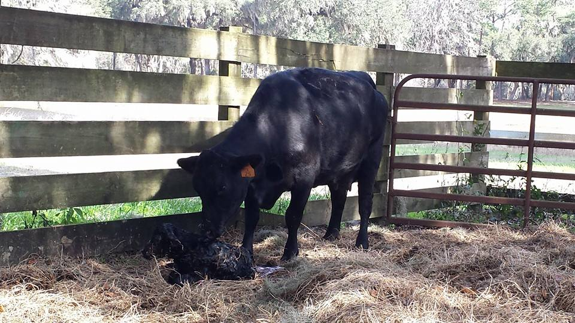
Objective 2
Determine the effects of prenatal trace mineral supplement source & breed on immunoglobulins A, M, G & Total Immunoglobulin concentrations
  Cow colostrum
  Calf serum

Slide 45
Effect of Trace Mineral Source on Immunoglobulin Concentrations in Colostrum
 | Treatments (T) and breed (B) |  |  |  |  | P-value
Variable, mg/dL | AN-ING | BN-ING | AN-ORG | BN-ORG | SEM | T | B | T × B
n | 10 | 11 | 11 | 10
IgG | 10,196 | 11,048 | 11,638 | 11,558 | 1006 | 0.34 | 0.70 | 0.65
IgM | 397 | 332 | 423 | 517 | 58 | 0.08 | 0.81 | 0.17
IgA | 586 | 384 | 633 | 531 | 79 | 0.23 | 0.06 | 0.53
Total Igs | 11,180 | 11,764 | 12,693 | 12,605 | 1,054 | 0.27 | 0.82 | 0.75
Notes:
IgA 2 Found in mucosal areas, such as the gut, respiratory tract and urogenital tract, and prevents colonization by pathogens.^{[13]} Also found in saliva, tears, and breast milk.
IgG 4 forms Major one in colostrum, provides the majority of antibody-based immunity against invading pathogens.^{[3]} The only antibody capable of crossing the placenta to give passive immunity to the fetus.
IgM 1 Expressed on the surface of B cells (monomer) and in a secreted form (pentamer) with very high avidity. Eliminates pathogens in the early stages of B cell-mediated (humoral) immunity before there is sufficient IgG.

Slide 48
Calf Immunoglobulins

Slide 49
Effect of Trace Mineral Source on Immunoglobulin Concentrations in Calf Serum

Slide 50
Notes:
Almost a 30 % difference
Add Trt* breed pvalue

Slide 52
Notes:
About 33% greater for ORG & 28% for Angus

Slide 54
Notes:
A 23 % greater concentration in ORG

Slide 55
Summary
Prenatal Mineral Supplementation:
  ORG Increased
    12 & 24 h calf serum IgA
    30 d calf serum IgG
  ORG tended to increase
    Colostrum IgM
    Calf serum 24 h IgA, IgM & Total Igs
Breed: Angus > Brangus
  Colostrum IgA
  12 h Serum IgA
  24 h Serum IgA tendency

Slide 56
Overall Conclusions
Organic TM increased calf Ig concentrations
  Potential for enhanced calf immune status
  Potential enhanced response to vaccination programs
  Potential on reduced stress response to weaning
Calf WWT, ADG, & ADJ 205 greater for ORG than ING.
Cow and calf TM status influenced by TM source, sample time, and breed.

Slide 57
Introduction
Research program
Extension program

Slide 58
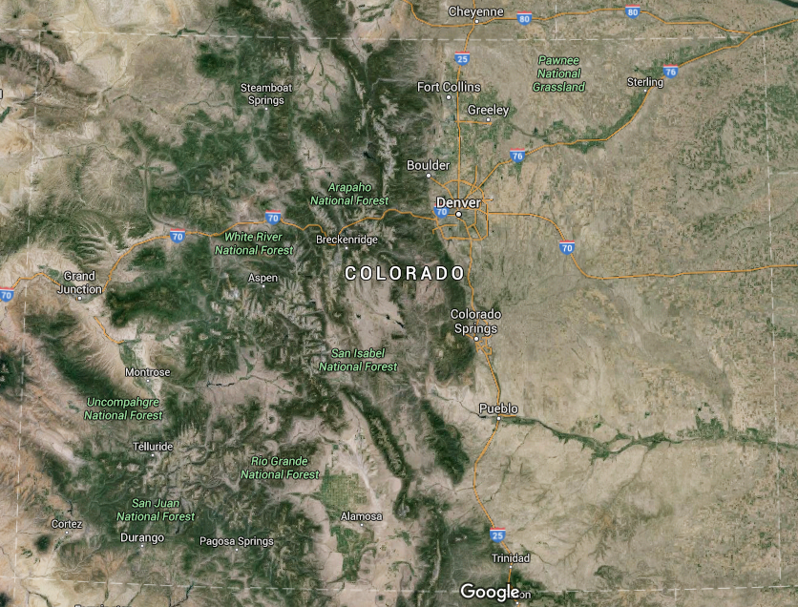

Slide 59
Sustainability: Executive Summary NCBA 2014

Slide 60
Sustainability: Executive Summary NCBA 2014

Slide 61
Research and Extension vision
Producers, Stakeholders, Advisory Boards
  Goals?? Production efficiency, sustainability, stewardship
Systems approach…..........
  Economics, nutrition, reproduction, genetics, meats, food safety
  Forage & range resource, water & land use, wildlife
Cooperative/Integrated projects & programs
  Systems team: faculty, graduate students, etc
  Extension agents: local, multi-county, statewide, regional
  On farm & ranch directed research
Deliverable outcomes

Slide 62
Extension: Audience Survey
  “When you talk you are only repeating what you already know. But when you listen, you may learn something new” Unknown
  Sometimes we just need to listen!!
    Stress the importance of effective listening!!!

Slide 63
Extension: Audience Survey
  “Everyone is ignorant, only on different subjects”
  - Will James

Slide 64

Extension: Audience Survey
Face to Face, Video, I-Chat, email, written surveys
  Farms, ranches, feedyards, packing plants
  Advisory groups, CCA, CLA, Allied industry
  County agents, state specialist
  University personnel: Departments – faculty, staff
  Other: BLM, Forest Service, Wildlife groups, etc
  Public, schools, media

Slide 65
Extension: Program Planning
Engage stakeholders in dialogue
Situation analysis
  Develop planning teams
  Issues & priorities, funding, resources, barriers
Develop programs with goals, and objectives
  Specific, Measurable, Achievable, Relevant, Time-limited

Slide 66
Extension Program Planning
Develop program and materials
  Material availability, resources to deliver material
  Future may be dictated more $$ than anything
Deliver program
  Activities performed by target audience
  Collecting feedback from participants
Evaluate, Analyze, Report
  Feedback, outcomes, objectives achieved
Program improvements, modifications

Slide 67
Extension: Delivery of Educational Material
Web based delivery: static vs. active and user friendly
  Goals & Objectives,
  Content & Topic areas
  Information delivery: fact sheets, articles, audio, videos
  Multi-county, statewide, regional utilization
  Web chats, Webinars, Live-stream, Recorded
  Maintenance, keep it current, DON’T reinvent the wheel
Print or visual media

Slide 68

Extension: Delivery of Educational Material
Social Media
  Youtube videos
  Facebook
  Twitter
  Instagram
  Who is our audience??
  What are our goals??
  Do we actually form a connection??
    Is it worth the time investment??

Slide 69
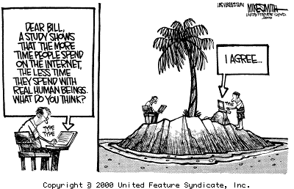

Slide 71
Extension: Program Delivery
Cooperation with extension agents is critical
  Program development & delivery
  In service training, research & demonstration projects
County and(or) multi-county programs
  Arkansas Valley Livestock Symposium
  Northeast Colorado Livestock Symposium
  Western Colorado Beef Symposium
Regional: high plains and intermountain
  Range Beef Cow Symposium
Notes:
WCBCS
Industry outlook, Poisionous plants, High Altitude disease, Cow size, Learning from the land, Cattle Theft, Sage Grouse, Scours
Retta Bruegger CST Outreach and Research Coordinator
NE Colorado
Schedule
9:30am Welcome and Introductions
Nolan Stone, CLA President-Elect
9:45am Keynote: Protein Markets in Transition
Lance Zimmerman, CattleFax Analyst
10:45am Antibiotic Resistance and the Veterinary Feed Directive
Dr. Del Miles, Veterinary Research and Consulting Services
11:30am “Aloha, healthy calves” – Long-haul shipping from Hawaii to the US Mainland
Dr. Ashley Stokes, CSU College of Veterinary Medicine
12:00pm Lunch Break
1:00pm Issues Impacting the Livestock Industry
Bill Hammerich, Colorado Livestock Association
1:15pm Beef Quality Assurance Program Updates
Libby Bigler, Colorado Beef Quality Assurance Coordinator
1:30pm Electronic Brand Certificate Demo
Jason Burns, Colorado State Board of Stock Inspection
2:00pm Updates from the State Veterinarian
Dr. Ken Newens, State Veterinarians Office
2:30pm The 3 S’s of livestock production. Safety, Stockmanship, and Stewardship.
Curt Pate, Curt Pate Stockmanship (Approved Safety Group Meeting)

Slide 72
Extension: Program Delivery
Types of programs
  Hands-on workshops
    BQA, cattle handling, reproductive management
    Economic and budget analysis (Ag Econ)
  Round-table discussions, focus groups (specific)
  Non-traditional
    Youth field days, special interest groups, general public
Demonstration and(or) research projects
  Farm, ranch, feedlots, sale barns, extension offices
Video & web conferencing

Slide 73
Extension: Potential Programs
  Reproductive management ($$)
    Synchronization & resynchronization: economics
    Replacement heifer development: nutrition & genetics
    Nutritional management of cows
    Bull development & predicting reproductive ability
  Beef cattle management ($$)
    Animal well being: weaning, shipping, health care, BQA, BMP
  Others
    Range, water, and wildlife management, public lands, conservation groups - interactions with beef industry
    Consumer & public education

Slide 74
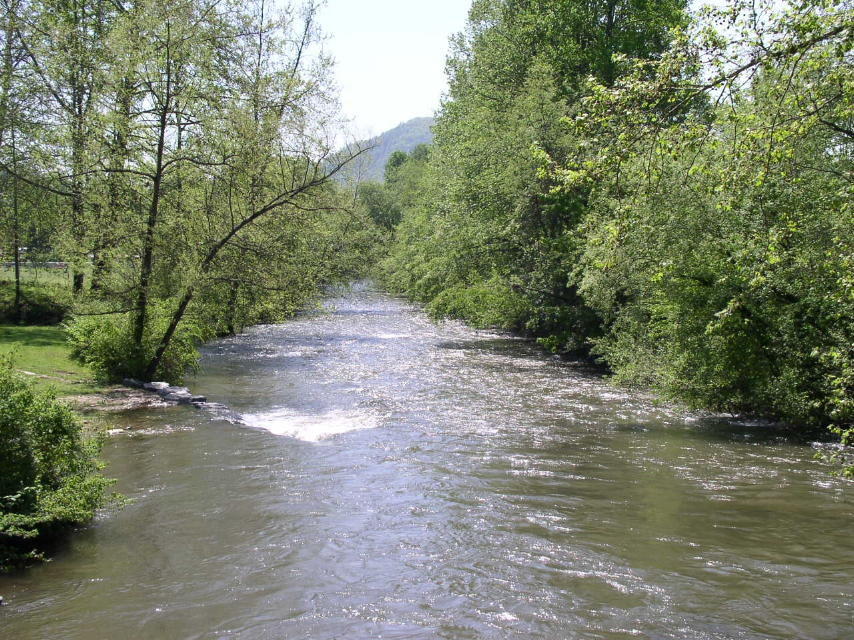
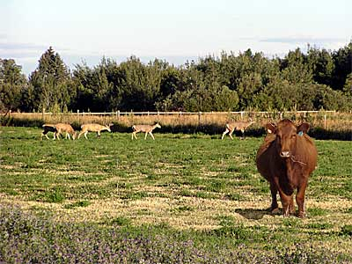
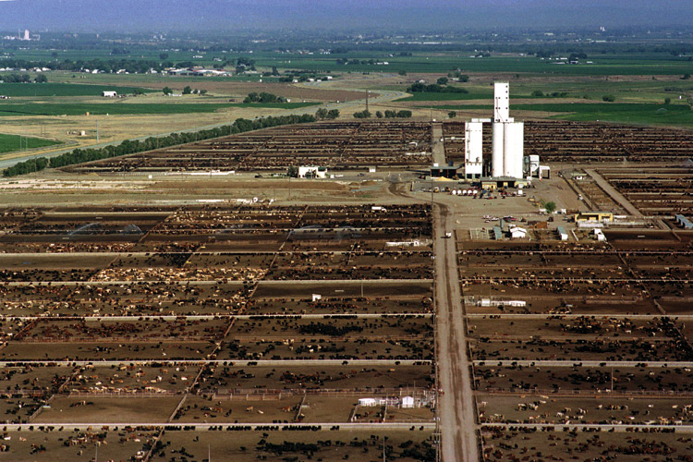
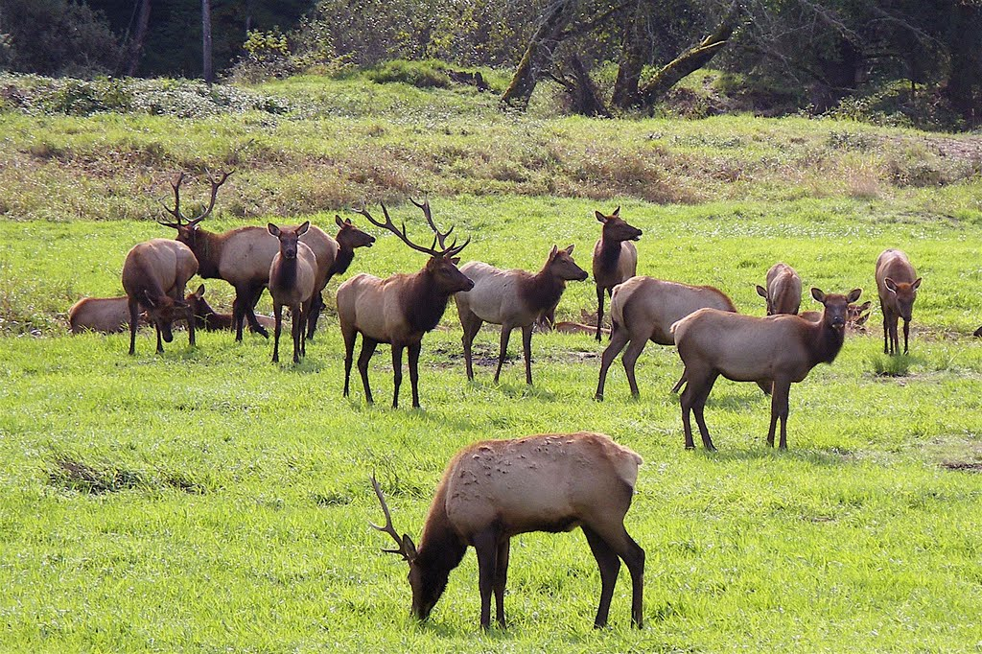
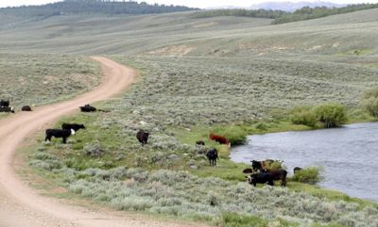
Others Challenges and Opportunities

Slide 75
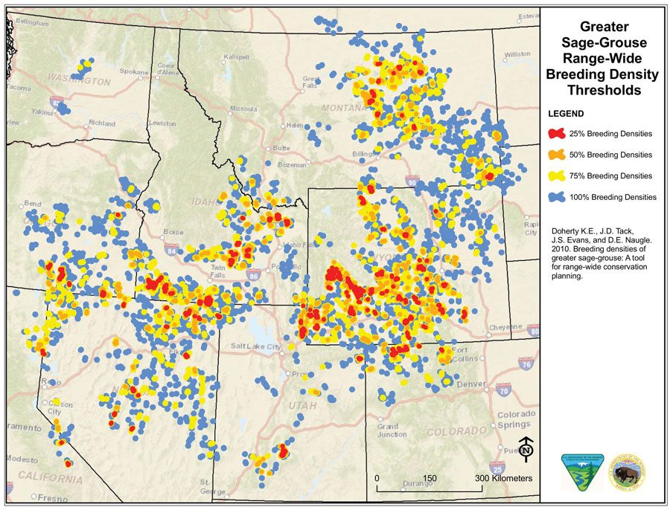

Slide 76
Research and Extension Programs
Funding
  Collaborative & integrative projects
  USDA-NIFA – integrated grants
    Research/Extension based
  Industry – allied & producer driven (State beef check off)
  Nontraditional sources (NGO, Not for profit)
  Fee based services
Graduate & Undergraduate student mentoring
Application of research: stakeholders and public

Slide 77
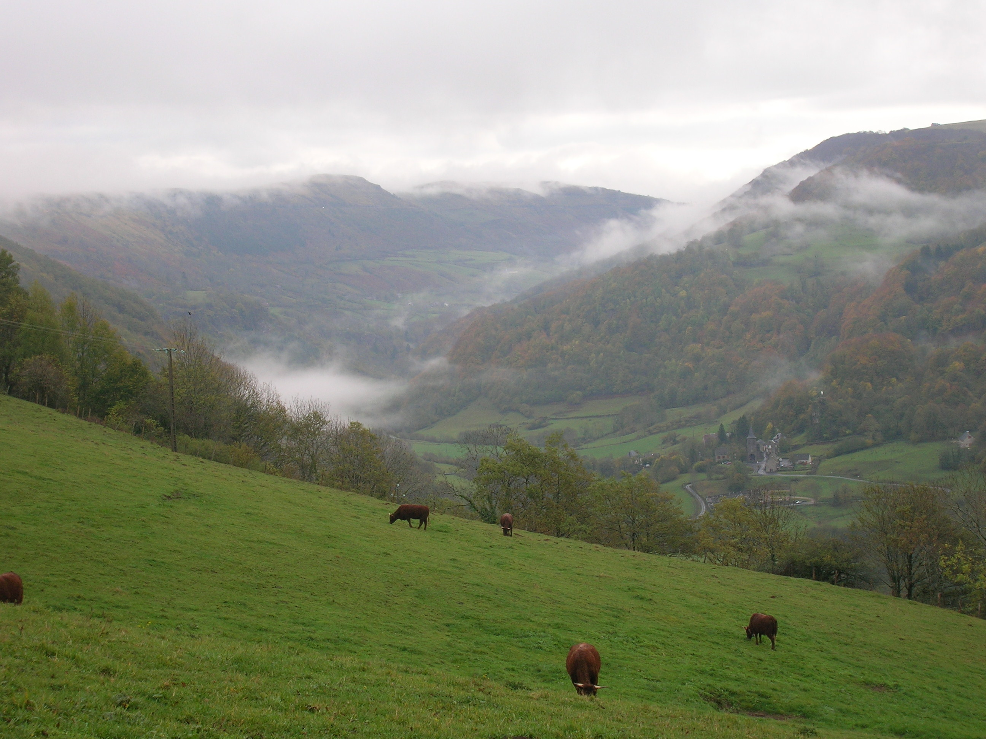
Thank you!! Questions?

